Slide 1




IS VACUUM EXACTLY NOTHING?
BY PARAM THAKKAR

Slide 2

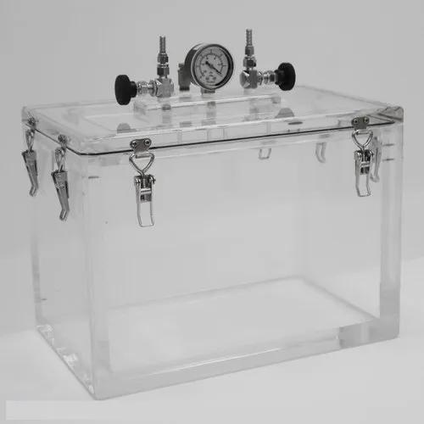

01
What is vacuum?
A vacuum is a space devoid of matter.
It is generally created for performing various science experiments and also has many industrial uses.

Slide 3
An atom is almost empty space.The nucleus of an atom is about 10-15 m in size; this means it is about 10-5 (or 1/100,000) of the size of the whole atom.
We are made
up of mostly
empty spaces?

Slide 4
Protons and neutrons are made up of subatomic particles calles quarks.There are 6 types of quarks : up, down, strange, charm, bottom, and top.Protons consist of two up quarks and one down quark, whereas a neutron is made up of two down quarks and one up quark.

Slide 5
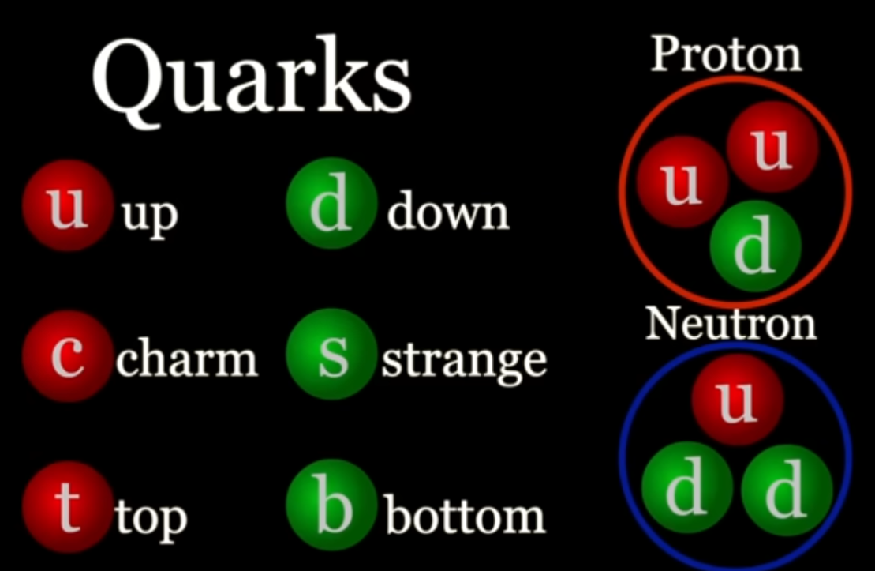

Slide 6
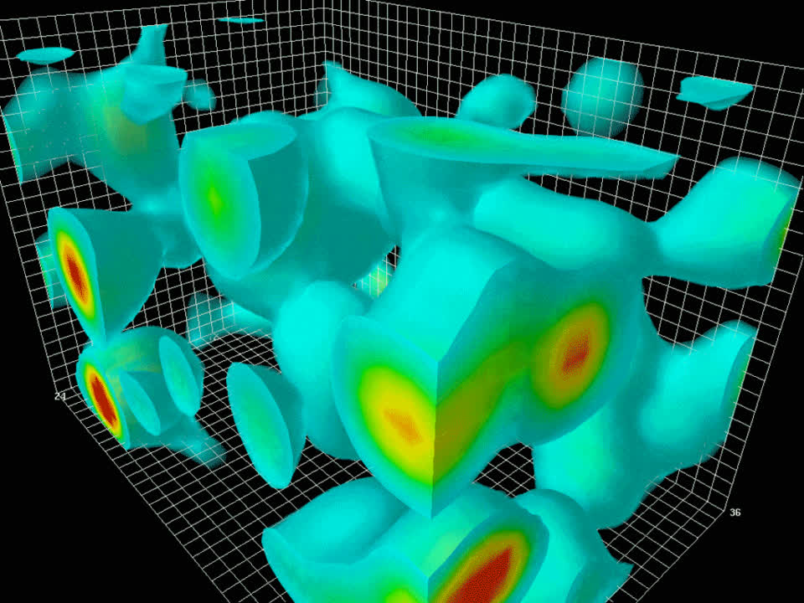
GLUON FIELD FLUTUATIONS

Slide 7
Where does these come from in empty vacuum?

Slide 8
It is due to quatum fluctuations in which a pair of particle and antiparticle is formed from space time (or from an empty space) which quickly merge together or annihilates to give that enrgy back to space time.

Slide 9
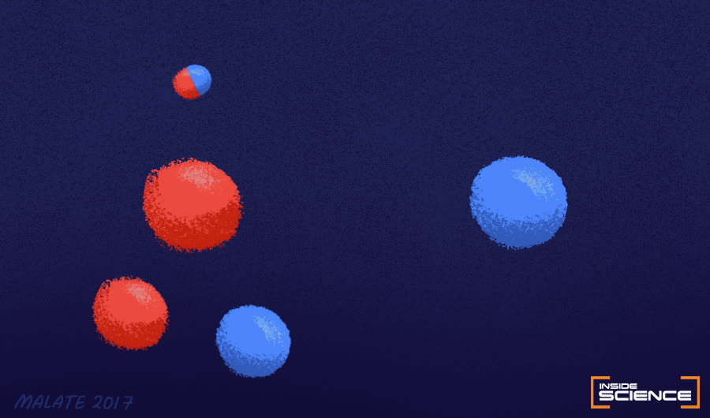

Slide 10
Don't you think that it violates conservation of energy?

Slide 11
Hiesenburg Uncertainty priciple for Energy and time
δE x δt>=h/4pi
where δE=mC^2
for example, an electron(e-) and an antimatter electron(e+) pop int existence. So, for how much time then?

Slide 12
δE=2δm_e x c^2
=2(9.1*10^-31)*3*10^8
= 1.6*10^-13
(1.6*10^-13)(δt)approx=h/4pie
δt=3.3*10^-20s maximum
Hence it can be violated by very small particles for very less amount of time.

Slide 13
THANK YOU

